Slide 1
ATAI
Advanced Techniqueof Artificial Intelligence
ATAI
ChongqingUniversity _{AdvancedTechniqueof}
of Technology Artificial Intelligence
Chongqing University of
Technology
Chongqing University ^{ATAI}
_{of Technology} Advanced Techniqueof
Artificial Intelligence
Chongqing University of Technology
Chongqing University of Technology
Leveraging Knowledge of Modality Experts for Incomplete
Multimodal Learning
Code:https://github.com/wxxv/MoMKE.
2024.11.17 •ChongQing
—— MM 2024
Reported by YaoChen Li
1

Slide 2
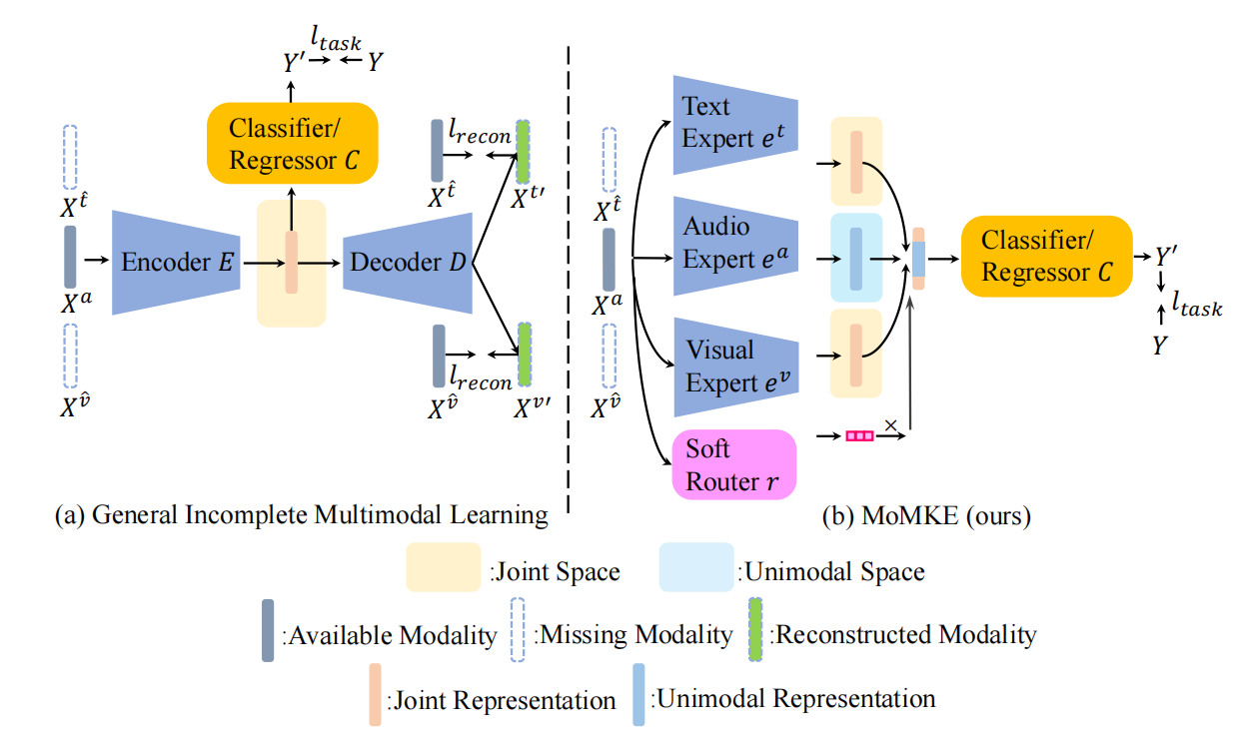
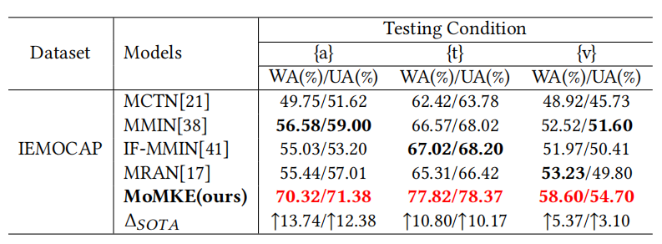
ATAI
AdvancedTechniqueof
Artificial Intelligence
ATAI
ChongqingUniversity _{AdvancedTechniqueof}
of Technology Artificial Intelligence
ChongqingUniversity of Technology
Motivation
(1)Existing multimodal models trained on complete multimodal data are not inherently robust to incomplete multimodalities.
(2)Existing methods the neglect of learning unimodal representations, which in turn leads to insufficient discriminability in unimodal conditions.

Slide 3
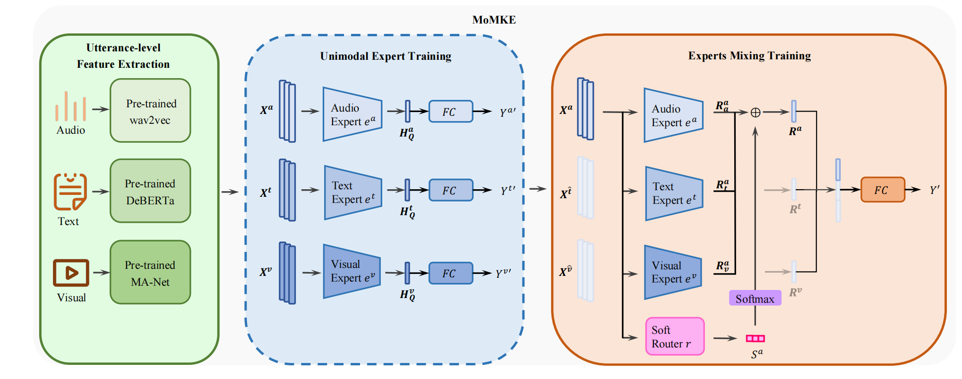
ChongqingUniversity of Technology
ATAI
AdvancedTechniqueof
Artificial Intelligence
ATAI
ChongqingUniversity _{AdvancedTechniqueof}
of Technology Artificial Intelligence
Overview

Slide 4
ChongqingUniversity of Technology
ATAI
AdvancedTechniqueof
Artificial Intelligence
ATAI
ChongqingUniversity _{AdvancedTechniqueof}
of Technology Artificial Intelligence
Method

Slide 5
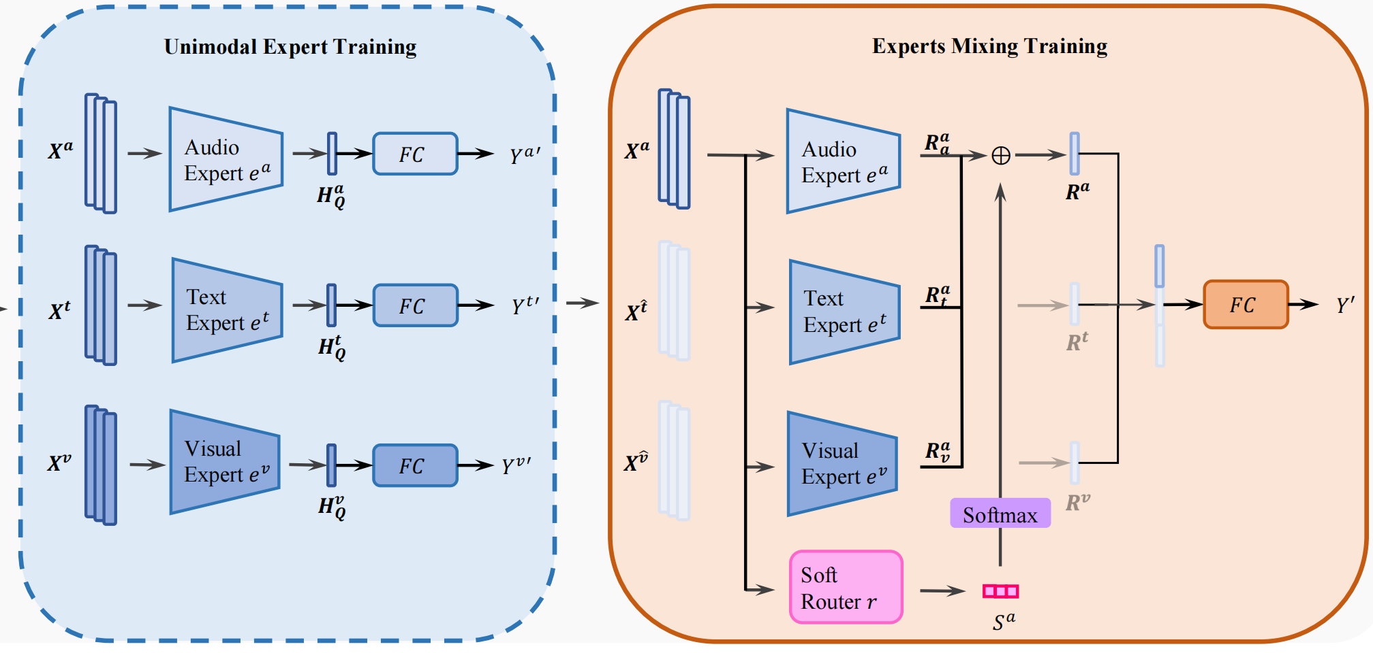
ChongqingUniversity of Technology
ATAI
AdvancedTechniqueof
Artificial Intelligence
ATAI
ChongqingUniversity _{AdvancedTechniqueof}
of Technology Artificial Intelligence
Method

Slide 6
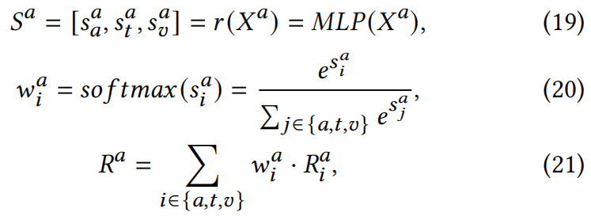
ChongqingUniversity of Technology
ATAI
AdvancedTechniqueof
Artificial Intelligence
ATAI
ChongqingUniversity _{AdvancedTechniqueof}
of Technology Artificial Intelligence
Method

Slide 7
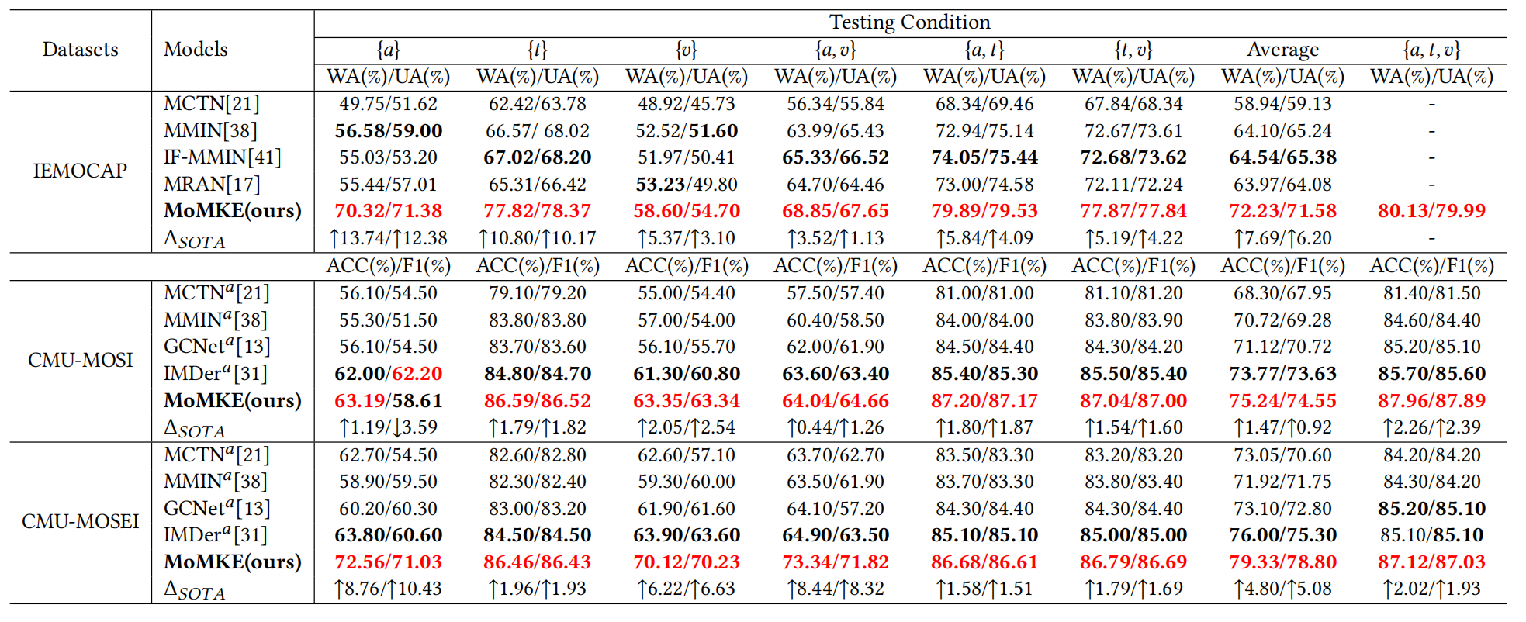
ATAI
AdvancedTechniqueof
Artificial Intelligence
ATAI
ChongqingUniversity _{AdvancedTechniqueof}
of Technology Artificial Intelligence
ChongqingUniversity of Technology
Experiments

Slide 8
ATAI
AdvancedTechniqueof
Artificial Intelligence
ATAI
ChongqingUniversity _{AdvancedTechniqueof}
of Technology Artificial Intelligence
ChongqingUniversity of Technology
Experiments

Slide 9
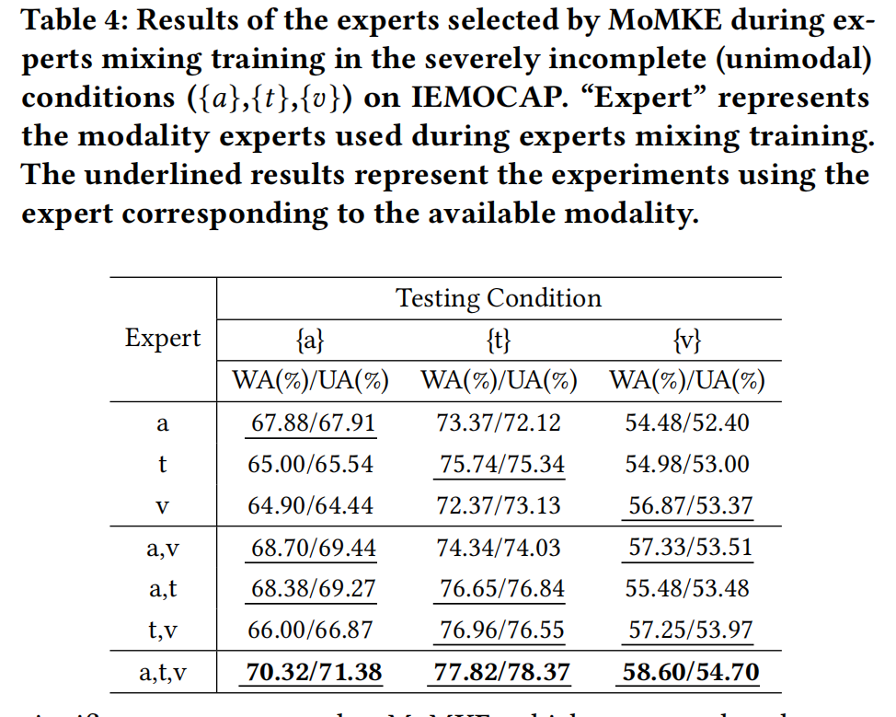
ChongqingUniversity of Technology
ATAI
AdvancedTechniqueof
Artificial Intelligence
ATAI
ChongqingUniversity _{AdvancedTechniqueof}
of Technology Artificial Intelligence
Experiments

Slide 10
ChongqingUniversity of Technology
ATAI
AdvancedTechniqueof
Artificial Intelligence
ATAI
ChongqingUniversity _{AdvancedTechniqueof}
of Technology Artificial Intelligence
Experiments

Slide 11
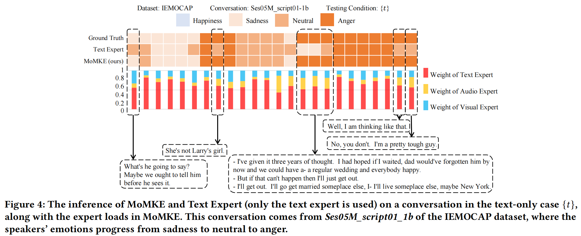
ChongqingUniversity of Technology
ATAI
AdvancedTechniqueof
Artificial Intelligence
ATAI
ChongqingUniversity _{AdvancedTechniqueof}
of Technology Artificial Intelligence
Experiments

Slide 12
ChongqingUniversity of Technology
ATAI
AdvancedTechniqueof
Artificial Intelligence
ATAI
ChongqingUniversity _{AdvancedTechniqueof}
of Technology Artificial Intelligence
Thanks!

